Slide 1
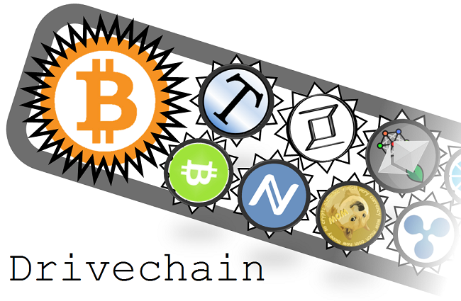


Sidechain Governance –
Why Involve the Miners? Paul Sztorc May 2016
Notes:
Bring up Segwit allows new scripting.
MAST - Merkelized Abstract Syntax Tree

Slide 2
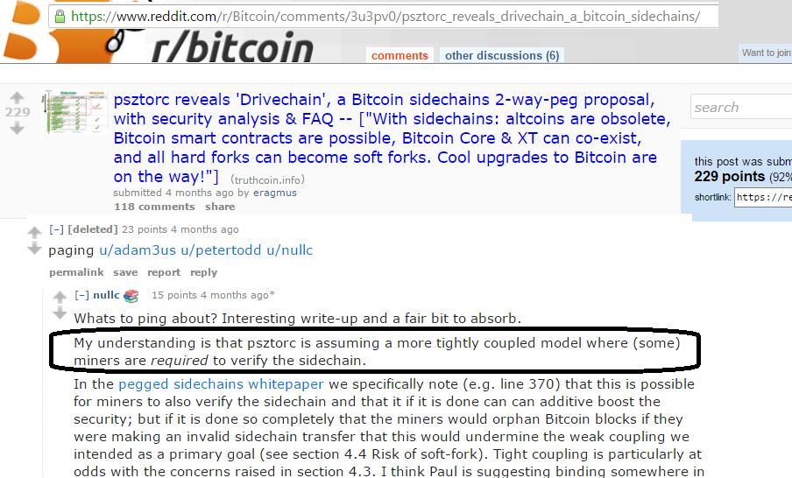
Motivation
Yes

Slide 3
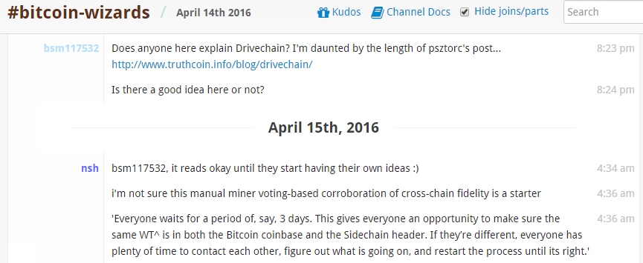
Motivation

Slide 4
Motivation
People do not want
the miners to have control over the sidechains...
...but I do...

Slide 5
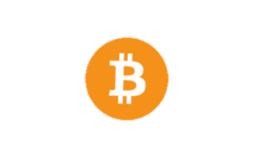
In One Slide – Contract Externalities
Entity
Bitcoin Miners
{ Sha256(Sha256(*)) }
Other Miners
{ Sha3(*) }
Other Miners
{ MD5(*) }
Sidechains
Sidechains
Sidechains
tx fees
Coinbase
If what they are doing affects me, I want a say in it!
Rewards per Block
Notes:
Might affect the value of the coins – the purchasing power exchange rate, or the total quantity of all tx fees.

Slide 6
Problem
Expectation: Additive
Reality: Ecological
y
y
y
y
y
y
y
x
x
x
+y, +x
y
+y, +x
x
Two new functionalities always add to each other.
Two new functionalities potentially subtract from each other.
Notes:
Bitcoin miners receive the 25 BTC coinbase, and (surely) the bulk of the tx fees. Surely

Slide 7
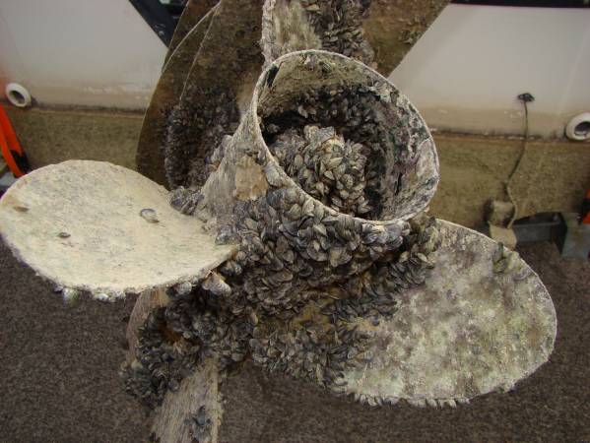
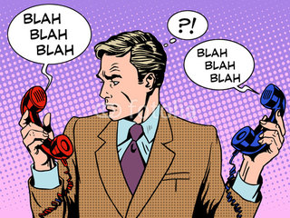
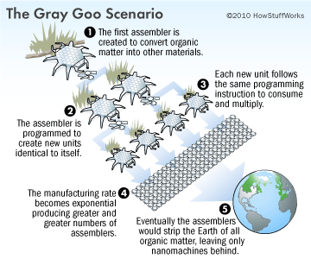
Metaphors for the Problem
Invasive Species
Spam
Grey Goo
“Censorship is Expression”
-- 1984 esque, but correct (b/c finite shared resources)
Notes:
https://upload.wikimedia.org/wikipedia/commons/thumb/0/0b/Zebra_mussel_GLERL_3.jpg/399px-Zebra_mussel_GLERL_3.jpg
These are Zebra Mussels, an invasive species. They used to live in this little Russian lake, but now they’ve “invaded” the Great Lakes of the US, and they’ve since spread just about everywhere. They grow so fast, that they sometimes cover the entire substrate, including everything that’s still living there. These other clams and mussels are buried alive – its horrifying. They’re tough, like cement, they’re very sharp. They can survive, out of water (and they smell pretty bad), for a long time, and they’re kind of ugly. They happen to be so effective at filtering water, that they are themselves (usually) poisonous. They are credited with killing tens of thousands of birds in the Great Lakes area since the 1990s.
Of course, there are winners – some fish (smallmouth bass and yellow perch) thrived in the cleaner water, and the fact that algae could grow in deeper waters.
After all, how can one ecology be *objectively* better than another?
Well, I have three comments.

Slide 8
Restated – What we want = SCs
Obvious: A smart contract enforces itself ... It does not require a 3rd party’s permission.
Not Obvious: This “permission” can be negative as well as positive.
Positive – “that someone approve”.
Negative – “that no one disapprove”.
(Smart Contracts attacking each other).
Turing Complete
Notes:
“...permission to enforce that execution.”
“Most people are very familiar with the concept of positive permission...”
If they can be easily attacked, then they aren’t smart, because they no longer ‘enforce themselves’.

Slide 9
Restated Again
“Non-trivial smart contracts can never be Permissionless.”
Permissionless Innovation
Permissionless Implementation
Sidechains, alt token systems, any new BTC-payment-mapping, or a system which implements those mappings ...
R & D
Confidential Txns
R & D
Poker
Alarm Clock
Confidential Txns
Barrier: Controlled by conservative BTC-Value-Maximizers
(aka “Miners”).
Poker
Alarm Clock
Alarm Clock
Turing-Completeness can’t be allowed (enables permissionless implementation).
Notes:
Code “whatever you want” on a local machine, the make “the Alarm Clock sidechain” or “the Poker sidechain” or “the Confidential Transactions sidechain”
I’ve written Drivechain so that each new contract always requires ongoing miner-consent.
In the first place, I don’t intend to say that. Primarily, this presentation is about being aware of the interconnectedness of smart contracts, so that we can make an informed decision.
Turing Completeness does not allow us to make such a decision.

Slide 10
Why am I worried?
Two Examples of “Cannibalism” (SCs Harming and Obviating each other)
PI Disables the (much much cooler) “Oracle” Contracts.
Use PI (TC) to steal Bitcoin, while disabling TC!
Theory -- Why Blockchain “Permissionless Implementation” isn’t good, anyway.
Costs and Benefits of General SC.
Ethereum Misunderstands the Trust Problem (Solved by Brands / Blockchains) – TC without Ethereum.
Bitcoin = Game-Theory, not CS (and why that matters for permissionless-ness).

Slide 11
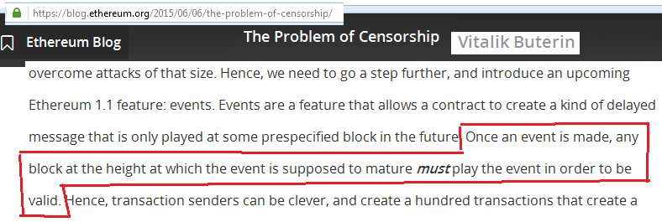
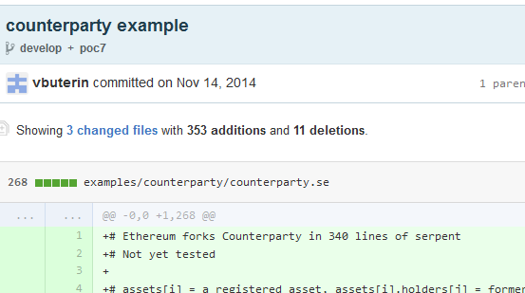
P. Impl. Harm - Assumptions
Any SC can get in, at least at first -- (the reverse = this talk’s thesis).
If miners attempt to censor, they face: obfuscation / multiple attempts / assembly-by-parts.
Otherwise...not really censorship-resistant? (...not really TC? )
SC’s allowed to be at-or-near the complexity of Bitcoin.
Notes:
In short, I assume that you have a Turing-Complete smart contract platform.
Or they can move in cycle or something.
It’s useless if you can censor individual contracts. Because you can hold the valuable contracts hostage, of course. However, what I’m going to argue is that the software is *also* useless at the opposite extreme – if you allow *any* smart contract to be introduced.
I don’t rely on high-or-low computation or bandwidth...
So, just be aware of what I have assumed.
Pitched as allowing more-complex things, distributed dropbox

Slide 12
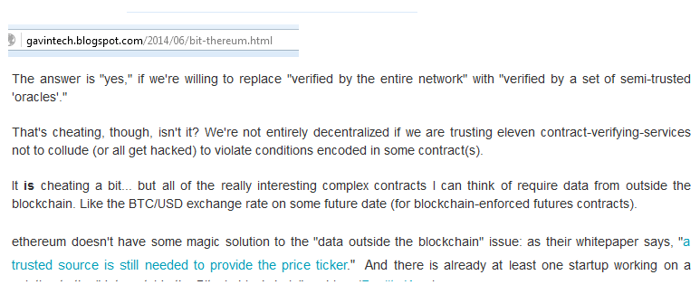
Ex 1 – Unsustainable Oracles
Gavin Andresen, on Ethereum
“Oracle”
P.I. Exposes a blockchain system to a “Reputation Free-Rider Problem”
Trivial Case: if Oracle is not going to control anything valuable, then no compulsion to lie, no need for trust, no need for blockchain.
Important Case: otherwise, the Oracle is going to incur an opportunity cost of theft – “trust” is required.
Notes:
Oracle controls where the money is going, just like a traditional bank.
We don’t want to only dial-out to Twitter, or Google. That’s obviously centralized...(the “bank of Google”). If we’re going down that road, we can just ask Google to sign Bitcoin transactions, or release a predefined multisig private key. The whole point is that these contracts execute themselves, no matter what Google or anyone does.

Slide 13
Ex 1 – Oracle Basics
Ultimately, oracles need to vary in quality (because we must choose them pre-report, and evaluate them post-report).
We necessarily ‘trust’ them, mid-event. Performance is (obviously) not guaranteed.
100%
=
99%
62%
2. Choice, (Event), & Report
53%
1. Choice
3. Evaluation
50%
Varying Quality
Notes:
There’s always some flexibility, or room for error, in the subjective (human-interpreted) part.
Image of inputs outputs, over time, bunched and aggregated as “track record”, equaling a ranked quality / reputation.
Since there is no guarantee of this, it will necessarily have the freedom to vary.
Ok, “oracles can lie” ... So what? Why am I spending so much time on this? Well, here’s the problem in one slide.

Slide 14
Ex 1 – Reputation Free-Rider Problem
Varying Quality
Recall, honesty is costly to Oracle...Oracle is forgoing theft-opportunities.
100%
Quality Premium
Oracle Fee (Paid Upfront)
99%
Labor
62%
f( )
53%
Setup
Info on blockchain, now a public, non-excludable resource.
50%
I’m always cheaper...
I will copy , when he reports.
Quality Premium
Labor
...and I’m always exactly as reliable.
Oracle
Fee
Setup
Result: “crypto-reputation” is impossible (all always 50% ) . No different from trusting website.
Other impossible things: all DACs, identity, fidelity bonds, financial markets.
In contrast, a single ‘mega-contract’ can (with entrants excluded) “coordinate” payment-events and oracle-quality events. It can force a mapping from quality to $.
Quality varies, payments don’t co-vary!
Can’t buy quality!
OUT OF BUSINESS
Notes:
Must charge enough to make up for your costs...else you’ll be relying on Altruism. Altruism + Anonymity = Disaster.
...into a fee which the oracle must charge. If the oracle cannot charge this fee for oracle-services, the oracle will have a direct incentive to attack and steal the money.
Labor – this cost can obviously be reduced with clever software.
While the Big Mac is cheaper, and obviously *worse* than the Deluxe Hamburger.
Satoshi’s whitepaper states that the main benefits are lost if a trusted 3rd party is needed to prevent double-spends.
Classic problem of tying the use of the “appcoin” to the outcome.
Identity – bridge between the two is an oracle.
Well, the main benefits of Smart Contracts are lost (Gavin Point) if a trusted 3rd party is needed to provide oracle reports.
Augur. Market for lemons. “secured by indifference”
Brands are very important – Seagate, Stop & Shop. Very very efficient. But they don’t work if someone can misrepresent themselves as your brand. That’s illegal, and is exactly the problem here.
Cancer – next one is invasive species.

Slide 16
Ex 2 – Stealing BTC Without the Key
Ex 1: Basic, Inevitable
Ex 2: Contrived, Unlikely
Notes:
A little bit of a stretch.

Slide 17
Claim: Steal BTC + Disable TC
Execution? Force miners to steal 1% of the outstanding Bitcoins (ie, 210,000...some individuals will lose all their BTC).
Strategy? Create a “near copy” of Bitcoin, which frees up 1% of the BTC. This 1% can be claimed by miners, if they disable the original Bitcoin (and everything attached to it).
Notes:
A little bit of a stretch.
Winklevoss Twins apparently own 1% of the BTC – they could be the only ones affected.
For fun, I tweaked the example so that it only works if you blow up Turing-Completeness while you’re at it.
This is how I spend my Thursdays.
(purposefully deficient ... Just as adding options is can leave you vulnerable, removing options can strengthen your strategic position).

Slide 18
Tools
“Observation”
It is possible to watch Bitcoin-1 from Bitcoin-2.
Events in B2 can be made to depend on events in B1.
Possible to ~instantly move BTC from B1 to B2.
Poker
Alarm Clock
2
1
“Half-Surrender” (Voluntary / Recyclable 2wp)
The Rules: every 2 months, there’s one special block (in B2) where individuals can use their B1-keys to ‘mint’ B2-BTC. These minted coins can move freely throughout B2, as long as their parent coins have not moved twice.
After 99% of the B1-BTC have been H-surrendered, this stops working.
Notes:
In fact, in Ethereum / Rootstock as currently envisioned, extremely easy.
If these are to be merged-mined, it is a requirement
How do I implement the peg? Very carefully. Why twice?
Not twice – game over, not twice but once.
Twice “you’ve already made your decision” – zero times is the starting state.
Well, either [1] you have the option of sending the coins on B1 to a provably unspendable address, with your single valid move. Or, [2] if B2 collapses, you can move the coins on B1 twice and effectively reclaim them.
In this way, everyone has an incentive to put all of their coins “in stasis”. No matter what happens, they can’t lose.

Slide 19
Tools
Dominant Strategy: “Half-Surrender” all BTC you own, at every opportunity.
“Observation”
It is possible to watch Bitcoin-1 from Bitcoin-2.
Events in B2 can be made to depend on events in B1.
Possible to instantly move BTC from B1 to B2.
Poker
B2 Won | B2 Lost
Burn the coins on B1, by sending them to a provably-unspendable address. Now, other people will accept your B2 coins. | Reclaim the coins on B1, by sending them to yourself twice. (Or, doing nothing.)
Alarm Clock
2
1
“Half-Surrender” (Voluntary / Recyclable 2wp)
The Rules: every 2 months, there’s one special block (in B2) where individuals can use their B1-keys to ‘mint’ B2-BTC. These minted coins can move freely throughout B2, as long as their parent coins have not moved twice.
After 99% of the B1-BTC have been H-surrendered, this stops working.
Notes:
We already have a “dominant strategy” for BTC-owners...(ie holders).
In this way, everyone has an incentive to put all of their coins “in stasis”, and NOT spend them twice in B1. If they need to spend their coins, on B1, they should do so, and then just redo the surrender.
Can’t tacitly coordinate to ignore this threat, because compliance is only possible once per two months. No way to prove that you are resisting the contract (because it looks the same either way, because compliance is only possible at rare times).
Morevoer, there’s time pressure, because if you miss out you’ll have to wait 2 weeks. No matter what happens, they can’t lose.

Slide 20

Tools (targeting miners)
Forced Dilemma
After a certain network time is reached, B2 needs 1 of 2:
B2 must be empty (ie, B2 is choosing never to update).
Nearest B1 block is complying with ‘arbitrary soft fork S’.
Thus, B2 can “ask” B1 to perform any soft fork.
Endgame Payout
Pays X coins (on B2) to Y recipients, conditional on some future block being reached.
Choosing X and Y?
B1
B2
Deterministic payout
Notes:
We’ve got the coin owners. Now we’ll just need a critical mass of miners, and it will be a done deal.
Miners are very...gravitational. All points in space, so to speak, are equally arbitrary.
Here’s another basic rule. It is simple but powerful.
Thus includes all soft forks which disable B1 completely. (After all, the fork ‘all B1 blocks are empty’ is a soft fork). We don’t need B1 to be completely empty, merely that it can’t include Bitcoin transactions (value transactions). Maybe it can include Counterparty OP RETURN or other sidechain tx or whatever.
But you can do quite a lot with a soft fork, if the miners *care a great deal* about B2 (and don’t want B2 to be empty).

Slide 21
X&Y to Entice Miners
X (Coin Payout) = Easy
Large enough to be enticing, but small enough to make victims ignorable.
...1% of the currently outstanding BTC
Y (Recipients) = More Complex
Who do we still need to bribe? The miners.
I propose a way to recruit miners which [1] rewards early rule-compliance [2] is ambiguous (contains plausible deniability).
Create temporary 2nd coin type: “compliance credits”.
B1
CCs created
B2
CCs destroyed (redeemed for B2-BTC)
Deterministic payout
Notes:
We don’t want anyone to care about the victims, or identify with them. We want users to say “that sucks, but, it’s not my problem”.
And I’ll explain why I’ve chosen these two factors in a moment.
How am I going to do this recruiting?

Slide 22
More Detail re: Two Factors
CCs (on B2) are awarded to B1 miners (identified by coinbase transaction).
Issuance schedule favors “early adoption”.
CC / coinbase tx
To achieve ambiguity:
For each B1 block, use (Attack Seed +) PrevBlock hash to (deterministically / pseudo-randomly) “sort” the B1-UTXOs.
The “top” β% are designated “frozen”. If anything is spent from them, the B2 chain does *not* give miners their Compliance Credits!
Miners have plausible deniability: “did not get tx”, “insufficient fee”.
t
Notes:
More detail about those two factors.
Impossible to prevent B2 from learning who mined a block on B1. Even in the case of P2Pool (multiple winners), one can just observe the amounts. That’s trivial.
“How are going to make it ambiguous, whether miners are attacking or not?”
“Everyone’s got a checking account in Bitcoin, and we’re going to shuffle the deck of checking accounts, and draw the first Beta checking accounts.”
In a each single block, an individual UTXO is very unlikely to be spent. Moreover, even if they are, miners have *excuses*. Miners can just include the transaction in the very next block...the foregone tx fees of each individual transaction are pretty small.

Slide 23
Compliance Credits (CCs)
Ideally, our signal would be tunably ambiguous:
At first, the signal is very ambiguous. Later, the signal is allowed to “lose” its ambiguity.
This is because: any identifiable miners who are purposefully malicious are likely to suffer retribution.
β
Attack completed. (Bitcoin-1 disabled.)
100%
Attack must succeed.
40%
Attack begins. Mysterious / occasional problems.
time
Notes:
Now I’m going to explain why I chose those factors – time, time is the key!
Retribution in one form or another.
“attack can sneak by both hurdles”
So, early on we will be addressing the word “purposeful” (by making the attack ambiguous), and later on we will change to focusing on the word “malicious”. After the attack-success is inevitable, there’s nothing malicious about helping the attack continue. “It’s too late to stop, what do you want me to do?”

Slide 24
Dominant Strategy for Miners
Create many “B2”s (and seeds).
BTC txns provide entropy.
Initially: accrue CC’s passively.
New gravitational centers will emerge and attract miners.
These miners now have a vested interest in the attack.
If slow to join, the deck might shuffle against them.
Miners may recruit a 51% group with side-payments.
2
2
2
2
2
2
2
Poker
2
2
2
2
2
2
2
2
2
1
Notes:
Accrue CC’s *within* each B2 by luck.
There will be lots of attempts, and some of those attempts will end up with a 51% miner coalition which wants the attack to succeed. Remember, “losing” miners don’t lose any coins – it’s the status quo to them. “Winning” miners can grab an extra 210,000 BTC.

Slide 25
Dominant Strategy for Miners
Create many “B2”s (and seeds).
BTC txnx provide entropy.
Initially: accrue CC’s passively.
2
2
2
2
2
2
2
2
2
2
2
Poker
2
2
2
2
2
Poker
2
2
2
2
2
2
2
2
2
2
2
2
2
2
2
2
1
1
Notes:
Accrue CC’s *within* each B2 by luck.
There will be lots of attempts, and some of those attempts will end up with a 51% miner coalition which wants the attack to succeed. Remember, “losing” miners don’t lose any coins – it’s the status quo to them. “Winning” miners can grab an extra 210,000 BTC.

Slide 26
Neutralizing a “Symmetry Defense”
If Person A can use move Y(D), which alters the game-state “in direction D”, then why can’t Person B use Y(-D), which knocks the state in an opposite direction?
In fact, with smart contracts, this is even easier
P + epsilon attack example.
Notes:
Neutralizing Smart Contracts -- just make the opposite!

Slide 27
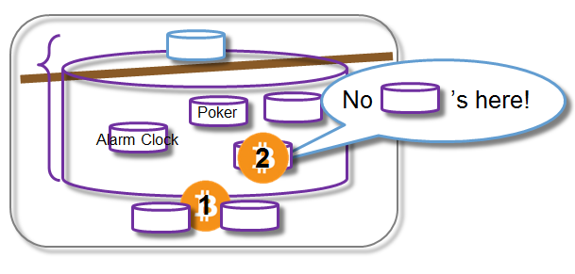

TC / PI is Automatically Removed
$$∞$$
...
By leaving the attack open to repeat, agents will have an incentive to disable the “repeat-enabler”.
Consider the *removal* of Turing-Completeness – it [1] has benefits (stability, “no more attack contracts”), and [2] can only be done once (can’t remove something which doesn’t exist).
Notes:
I originally had done the attack a slightly different way, to prevent someone from saying “that will never happen, Paul, because if it did, the precedent would shatter the credibility of Bitcoin too much”. But I’ve since changed it again, to both [1] avoid that criticism, and [2] achieve my bonus goal of disabling TC ness.
Might be done by strongly limiting the script.
In reality, of course, miners would just watch this presentation, and not allow Turing Completeness.
Learn the lesson the easy way or the hard way, it is unstable in this example.

Slide 28
No ’s here!
Poker
Alarm Clock
2
1

Slide 29
Part II – Cost/Benefit
What are we throwing away if we lose Permissionless Implementation?

Slide 30
PI – Costs and Benefits
Costs
Bad Smart Contracts “Anarchy” (Unreliable Environment)
Uncertainty / Open-Endedness / Instability
Benefits
Immune to censorship from miners.
If many applications need to be created/added quickly, or on an ongoing basis, then we benefit from faster onboarding.
Notes:
Would seem prudent to compare the costs and benefits
More risk / uncertainty means that more people will “wait and see” – less capital investment. ...because there’s greater risk that such investments won’t pay off (for any number of *unknown* reasons).
Also can’t prevent a good idea from flourishing.
How many applications are there? What’s the rush?

Slide 31
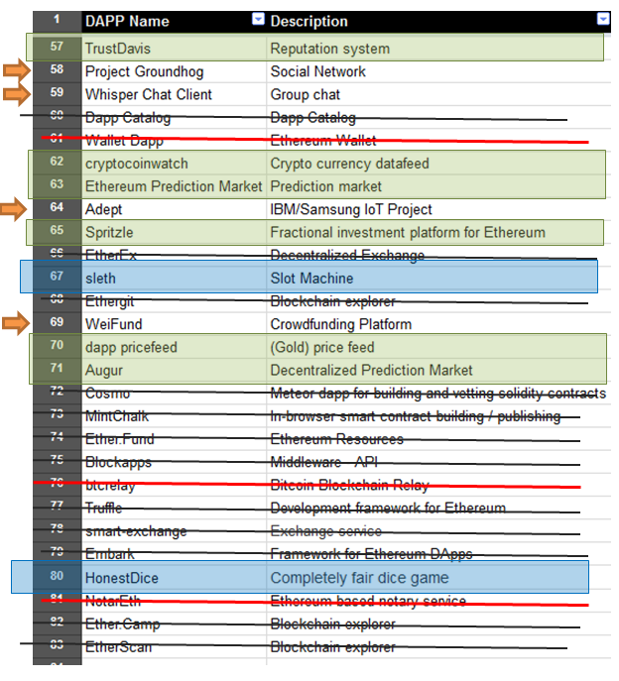
SC Applications
Aug 2015
At “Demo” level, or higher.
Provided by Ethereum Team.
Intermediate
In Bitcoin Already
Oracle (flawed) Casino
Notes:
Black strikethroughs are for “intermediate goods” (only as useful as whichever final good they support), red denotes “already in Bitcoin”, green denotes “Oracle” (will not survive parasitism), and blue denotes “casino”. So, including the new provably-fair pyramid scheme, “casino” characterizes 3 of the 7 discovered uses.
None of the four errors (orange arrows) concern me: they are so clearly Bad Ideas (which are either [1] asking users to pay tx-fees for what they can already do for free, or [2] so prohibitively vague/complex that I have a hard time believing they are really at the “demo” stage). So, I’m confident that this theory will continue to hold up over time.

Slide 32
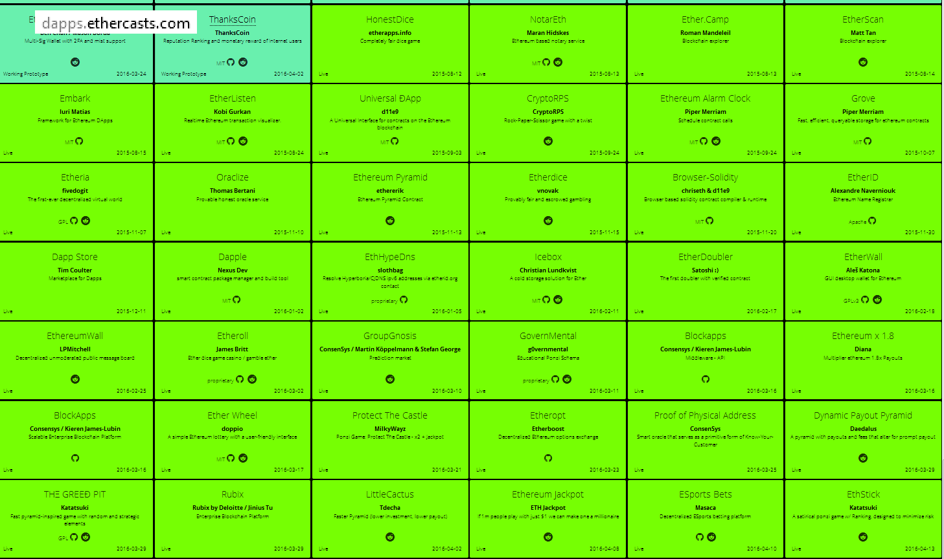

Slide 33
Notes:
Casino may be Ethereum’s main offering / value – proposition (or rather, Rootstock’s in this case).

Slide 34
Misunderstanding the “Trust Problem”
Institutional Value-Usage | Accepts Value | Stores Value
Examples | Restaurant, retail store, gas station, hotel, Netflix, iPhone Games, Uber. | Bank, brokerage firm, lawyer, government, bearer assets.
Qualities of Demand Met | Today’s needs: known, specific, flexible / capricious. | Tomorrow’s needs: not yet specified, (storage task is stable / well-defined).
Failures | Small, expected / investigative. | Large, unexpected / catastrophic.
Fail-Motive | Low: “Cash on hand.” | High: Total stored assets.
Creating Contract
Impact of bad Outcome.
Smart Contract?
Setup? Security?
Contract
Desire for flexibility.
Proof of Quality
Definition of Agreement
Motive to interfere.
Notes:
Use the idea of value, something which “protects” some value.
Social security.
Turkey burger, grilled chicken sandwich, You know what? I think I will take a Coke.
Could have had a bad meal, or the meal could be ruined in many ways. You’ve chosen to *accept* these risks
Try to cash a check – “your accounts are frozen”.
Why rob banks? That’s where the money is.
Smart Contracts compete with Brands – Online, the store maintains reputational capital,
Brands
Easy to [1] agree on, and [2] mutually-compute, a contract. Can constantly settle-up (via payment channels, perhaps). Make use of brands, reputational capital (think “dine-n-dash” / eBay / SilkRoad)
Conflict with “you don’t roll your own crypto”.
Where the process is well defined and doesn’t change, where there’s motive/opportunity for someone to damage the non-SC process, and where the damage actually causes nontrivial suffering.

Slide 35
Misunderstanding the “Trust Problem”
Institutional Value-Usage | Accepts Value | Stores Value
Examples | Restaurant, retail store, gas station, hotel, Netflix, iPhone Games, Uber. | Bank, brokerage firm, lawyer, government, bearer assets.
Qualities of Demand Met | Today’s needs: known, specific, flexible / capricious. | Tomorrow’s needs: not yet specified, (storage task is stable / well-defined).
Failures | Small, expected / investigative. | Large, unexpected / catastrophic.
Fail-Motive | Low: “Cash on hand.” | High: Total stored assets.
Just Try Again
Hard to Program
Impact of bad Outcome.
vs. Personal Relationships?
vs. Brands?
Creating Contract
Contract
Desire for flexibility.
Proof of Quality
Definition of Agreement
No One Cares
Motive to interfere.
Notes:
Blockchains are really only for digital bearer assets.
Restaurant – wheelchair.
SilkRoad
Almost everything in the real world is over here (left) and you really want to be over here (right), but Bitcoin is already taking care of most of the value-storage problem.

Slide 36
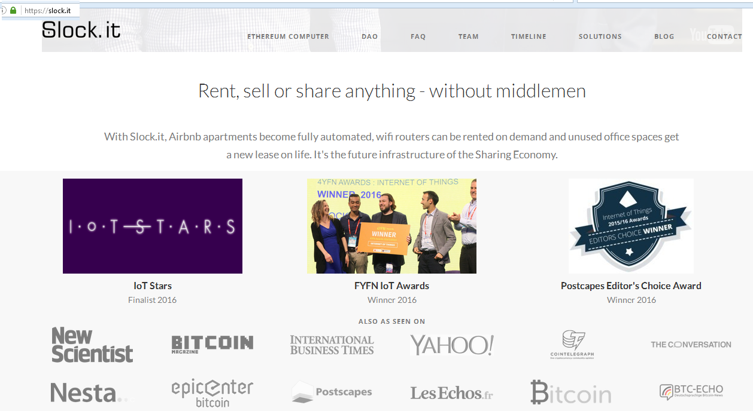
Slock It?
Notes:
Farce of the Week – The DAO

Slide 37
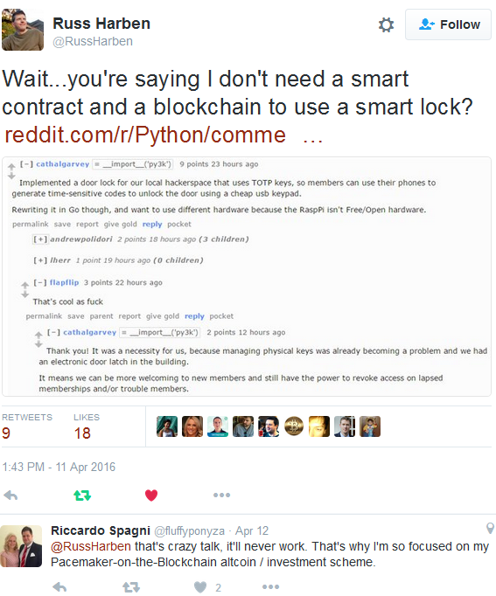

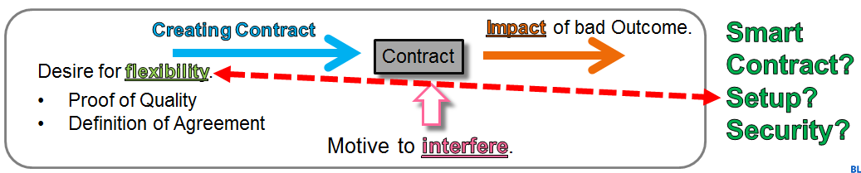

Slock It?
Location Revealed
Theft?
Identity/Reputation
(He’s joking.)
Notes:
Many pieces which are redundant (and anonymous or lacking a need for identity “peers”), geographically dispersed (in different regulatory environments to facilitate censorship-resistance and regulatory arbitrage).
This would tend to suggest that the “mistakes” hypothesis has some weight.
More flexibility in operating the lock, and for whom.
I mean, its basically “Ethereum slockit, without bugs, connectivity problems, network attacks.

Slide 38
If few, why interest? What do they know?
Perhaps nothing? Retail transactions, mining, marketcap, developer mindshare. Usual suspects: fad / bubble (“dot-com”, housing market, Beanie Babies), groupthink / tribalism, money / fame.
Bitcoin’s Affinity for Illicit Transactions
“Construal Level Theory” (Near/Far Modes)
Humans love to “profess” abstraction, to seem impressive. Reality is more specific, sensory, practical. Leads to grandiose planning errors, and instinctual pretentiousness (“social immune system” / “optical illusion”).
“One day I’ll write a book” vs. “The first sentence will be ‘…’ ”.
“One day we’ll have smart contracts” vs. “The first smart contract will be..”
Network Effects
 | Bitcoin | Legacy E-Payments | Cash
Dark Market
Light (e)Market
Notes:
Forecasting the future use-cases.
Need to explain why so many people are interested in Ethereum, despite nonexistent use-cases.
Network-Effect Flinching -- Mastercoin ($5 million to $120 million), Auroracoin, Ripple, Bitshares,
Something can look like a good idea, while secretly being a bad idea. Very common.
[2]
In addition to being (programmable money), Bitcoin allows you to compete in either market. “It’s not like you need to use Bitcoin for illegal transactions, but what if you, *or any of your trading partners* just want the option to conduct private electronic payments – anything from recreational drugs, tax evasion, filesharing payments, Wikileaks donations”.
They wouldn’t be sticking their neck out for Bitcoin, at all, if that were the case. “Bitcoin without the yuck. -- Bank / institutional anxiety (post-2008) w.r.t. auditing / backroom requirements...desperate for a solution.
[3]
Some literature suggests.
Not even subconsious.
Can practically feel your mind’s eye “refocus”.
Everyone says they want to write a book, but only those people who actually are going to write a book can answer the second part.
What can Ethereum do ... Blank stare ... What can’t it do?
Tendency for experienced software engineers to correctly forecast vaporware. Experienced software engineers are more mindful of “software rot” – tough reality of maintenance / limited time. Why the “blockchain” solves all of your problems...construal.
Politics – tendency to say “this is moral” (to sound impressive, or like a leader).

Slide 39
Better: “Ethereum without ETH”
Shard | New Instance
Access to mining. ( Protects Value of global ETH Token ) | Speed (Realtime, no need for BFT) Security (Independence, blame allocation) Modular (Use of BTC/PGP for value/ID)
Mining?
Notes:
Ethereum is, in some sense, the opposite of Bitcoin.
Contract Interference Problem
*Not* a positive externality -- transaction You don’t care – only two people interacting. Contract Profitability Problem – gas cost. Eventually converge to one type?
Ethereum is pointless -- data, to be displayed on a computer, calculations must be done on it. Computer-use implies calculation.
The Sharding Mystery – why not just go all the way?

Slide 40
Bloq Ora
Smart Contract Code
(or)
Business Logic
SC
Bloq Oracle – signs transactions.
“Dumb” Blockchain – verifies signatures.
Notes:
Not fully decentralized, of course, but neither is Bloq nor would the users of this service.
Because it is managed by us, it stands a chance of actually being useful for something. Namely,
Balance Sheet Externalities
Supply Chain semi-competition ( “data cleanrooms” )
Bloq Ora is better than Ethereum. People who want Ethereum, really want “software”, want “Bloq Ora”.
For every 100 people who think they want Ethereum, probably 90 of them are flat out confused, and 9 of the remaining 10 actually want Bloq Ora....it’s the Tierion to Ethereum’s Factom, if you will.

Slide 41
Part II - Theory
What are we throwing away if we lose Permissionless Implementation?
Multi-Sig
Hivemind
Vs. “Oracles” (awesome) ?
Vs. “Brands” (already have) ?
Vs. Bitcoin Soft-forks ?
Local Bitcoins
Purse.io
P2SH
Lightning Network
Notes:
Maybe it’s me, but I just don’t see anything. Leave a comment if you actually have a usecase that Ethereum can actually provide, that the internet can’t already do, or that Bitcoin can’t already do.

Slide 42
Part III - Theory
Do “Software Developers” and “Smart Contract Designers” have fundamentally opposite goals?

Slide 43
Contracts: Not Your Typical Software
Deceptive: “If you can use X to do Bitcoin, as well as do other things, then X must be better!” (ie, solving the general case).
Typically with software, built for one entity -- who wants maximal control/feature-set. More flexibility = ( new = always good ). No externalities.
Can simply set create_litecoin = FALSE
Additive View vs. Ecological View
Conflict of Interest
Notes:
Run the software with a flag –disable feature Q
You are the tyrant of your own computer.
Already pre-coordinated on a profit motive. Individual who is pre-coordinated on a survival motive.
“They aren’t going to be harmed by a feature that they decline to use.”
Imagine the grey goo – subtraction by addition
By what criteria should we compare these views?

Slide 44
Mechanism Design (“Reverse Game Theory”)
Bitcoin is what mathematicians would call a “mechanism”.
With game theory, task = you start with a game, and then describe the equilibria under different solution-concepts.
With a mechanism, task = you start with a desired equilibria, and then try to build a game which takes you there.
With, software, more is never bad …however...

Slide 45
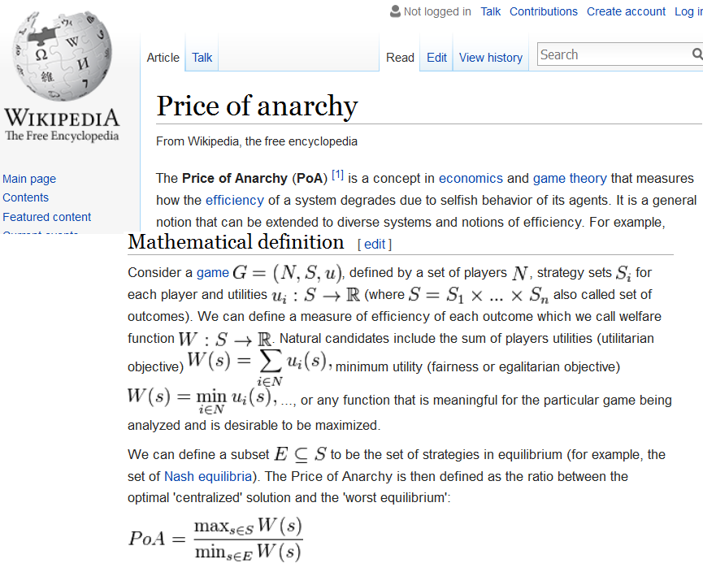
MD: Less is More
Notes:
7,7
9,1
1,9
5,5
Absorbing State NE

Slide 46
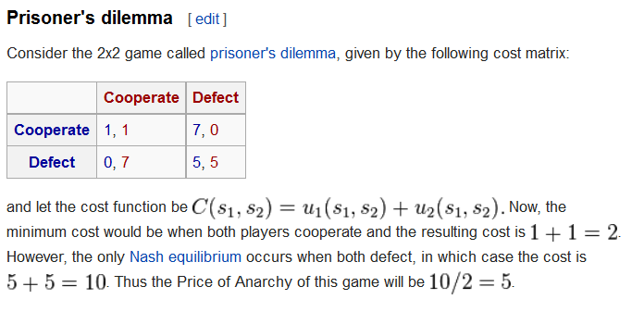

Slide 47
Contracts Tame Anarchy...via Subtraction
 | Cooperate | Defect
Cooperate
Defect
1
0
1
7
7
5
0
5

Slide 48
Usual Prisoner’s Dilemma (sans Contracts)
: (
 | Cooperate | Defect
Cooperate
Defect
1
0
1
7
7
5
0
5

Slide 49
Contracts Tame Anarchy...via Subtraction
I will NOT “Defect” if you agree not to “Defect”.
The “contract” is born...
 | Cooperate | Defect
Cooperate
Defect
1
0
1
7
If only neither of us had this “defect” option...
7
5
0
5
Notes:
“The software developer wants the computer-user to be able to do more things. The protocol designer wants each user’s computer to force the user to do fewer things.”

Slide 50
Contracts Tame Anarchy...via Subtraction
 | Cooperate | Defect
Cooperate
Defect
1
0
1
7
7
5
4 fewer years in prison, each...in a world where the players can NOT defect.
Each player would work up to 4 years to prevent such an option from existing!
0
5
The introduction of the “Defect” option effectively robbed the players of 8 total years of freedom.

Slide 51
MD: Less is More (continued)
How did that work? They agreed to do “fewer” valid things.
Contracts aren’t magic!
They “create nothing”.
They only operate on the space of human action...by shrinking it.
Less trust was required, under contract, because untrustworthy actions were removed. “Freedom” was destroyed.
Notes:
“The software developer wants the computer-user to be able to do more things. The smart-contract designer wants each user’s computer to force the user to do fewer things.”

Slide 52
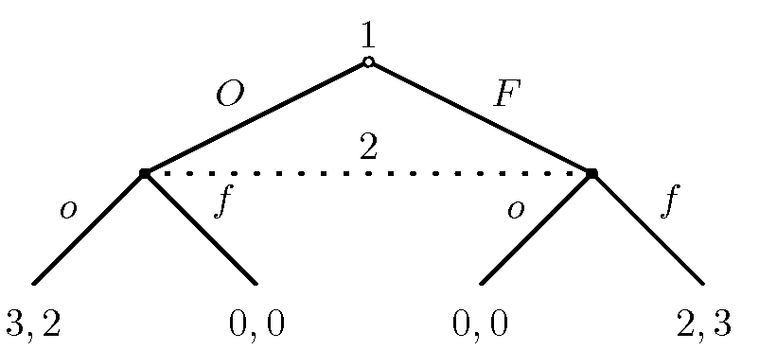
A Converse Example
“Battle of the Sexes”
 | _o | _f
O |  | 0, 0
F | 0, 0
2
3
3
2

Slide 53
“Battle of the Sexes + Bar”
B
2.5, 2.5

Slide 54
“ “Battle of the Sexes + Bar” + Bar ”
Q
2
??, 2.1
B
2.5, ??

Slide 55
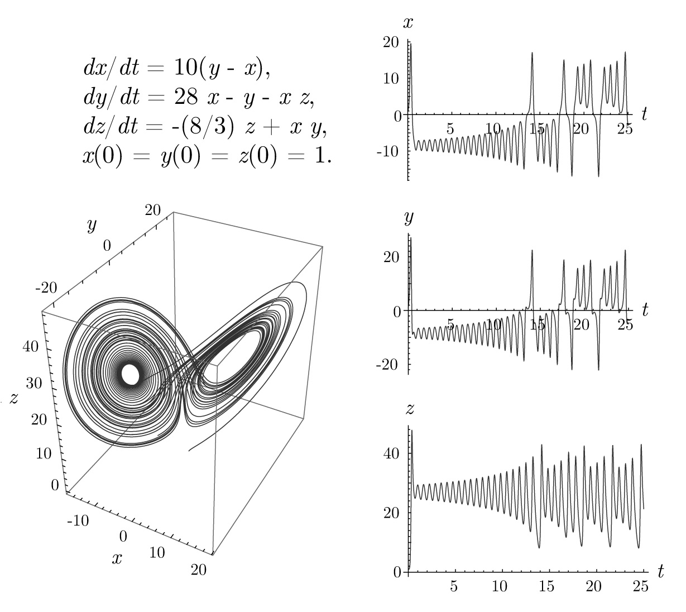
Escalating Interaction
(Lorenz System)
Curse of dimensionality.
2 ---> 3
3 ---> 4 8 ---> 9

Slide 56
Often, Controls are Good,
(they help with teamwork).

Slide 57
The Bitcoin Contract
Blocks are prohibited from including:
* transactions with bad signatures
* double-spends
Bitcoin’s main revolutionary feature: banned
double-spends. No need to trust a server to
protect you from double-spends.
Bitcoin is less functional / expressive than LevelDB...
Compare to: “Permissionless” Transacting
Notes:
Bitcoin is a normal database with a lot of stuff limited or removed.
Compare to Permissionless transacting, where you can do whatever you want. That’s bad because you might do an untrustworthy thing.

Slide 58
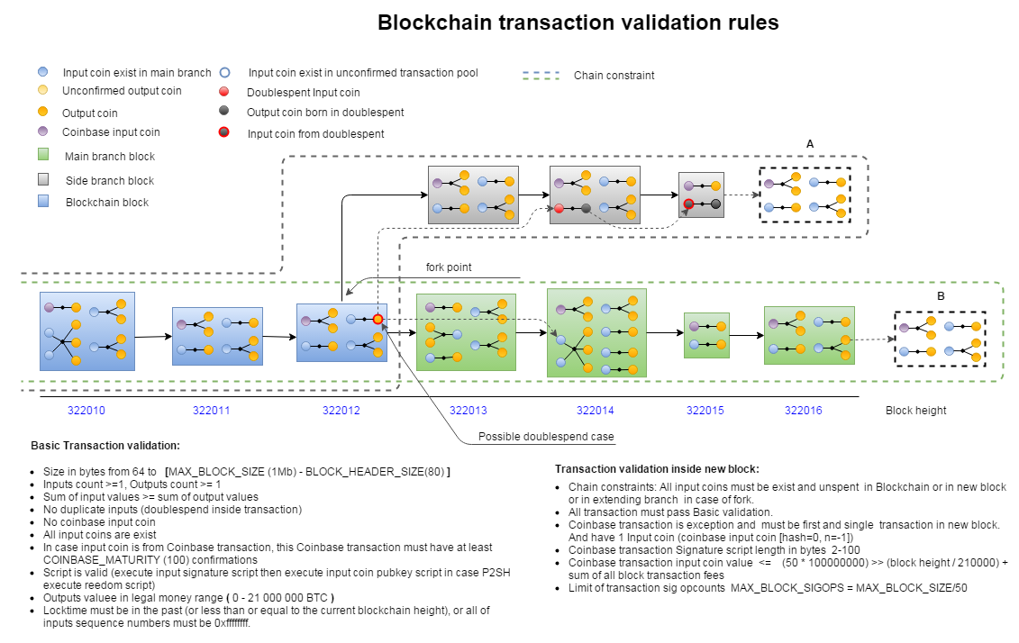
...a lot less expressive!!
Not My Work -- http://i.stack.imgur.com/QvgMr.png

Slide 59
How is Bitcoin Upgraded?
Notice that 100% of Bitcoin’s upgrades have been rolled out via “soft fork”.
Each soft fork is a reduction in total permission!
Forwards compatibility = no breach of contract.
Notes:
A hard fork breaches the established contract.

Slide 60

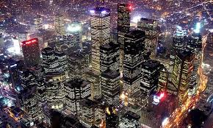
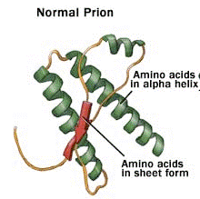
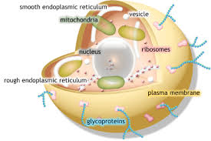
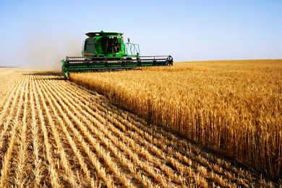
Autonomy and Coordination
“Freedom”
“Freedom”
“Freedom”
Prion Disease
Cancer
Constrains
Rioting / Theft
Constrains
Constrains
DNA
G - hormone
RNase H2
gene p53
T-cells
Firms / Employers
Property rights
Contract Adjudication
Police / Defense
Norms / Traditions
Lysosomes
Structure (Cell Wall)
Composition (Water)
Notes:
Damage, Mutuation, mitochondrial disease, cancer, riot
Virus would have been better
“Don’t loose the forest for the trees.”
“Autonomy” is not, in principle, better.
Hardcore anarchists dying of brain cancer, is perhaps the most ironic thing possible.
It would be silly to deny that a dictatorship can boast sound economic results. Any political system -- entrepreneurship, investment and trade, and makes a credible commitment to safeguard property rights to a certain extent will trigger a virtuous economic cycle.
Spain’s -- Francisco Franco
Singapore’s -- Lee Kuan Yew
1960s
China’s Deng Xiaoping
end of the 1970s
Chile’s Augusto Pinochet in the 1980s -- http://www.independent.org/newsroom/article.asp?id=1984
80% of economic activity takes place in “command” firms, with workers under contracts.
High Coordination, Low Autonomy, It just makes teamwork easier.

Slide 61

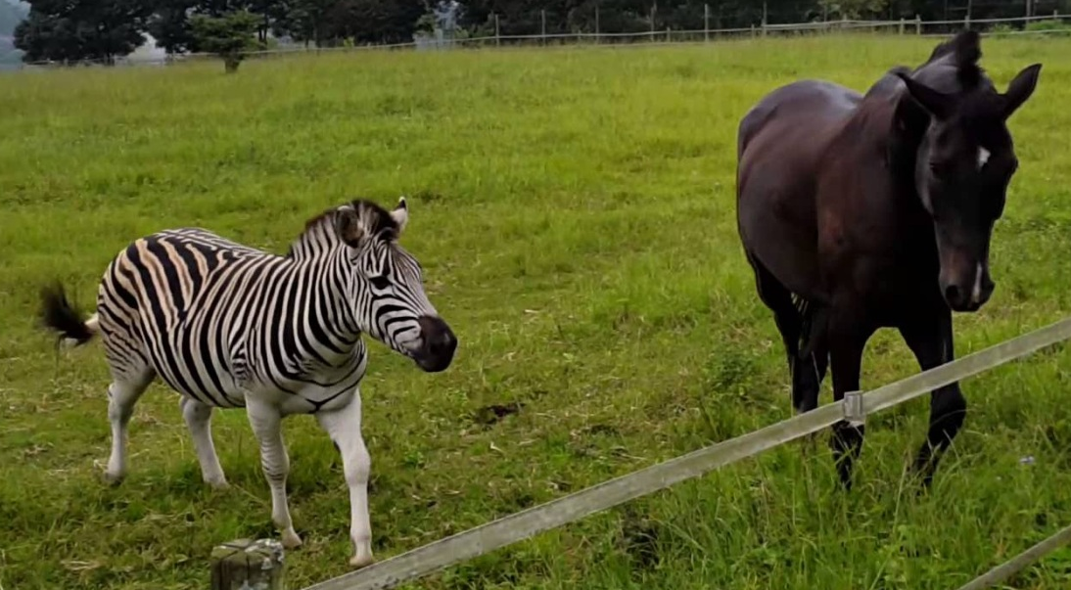
Instincts / Inborn “Preferences”
Domestication

Slide 62
Less is More – Biology
Life – Eukaryotic Cell – Multicellular Life – Social Animals – Domestication of Plants/Animals
Mitochondrial disease, cancer (individual cells start pursuing their own self-interest, they reject all laws as ‘unjust coercion’, but they don’t think it through, kill host, kill themselves), prey gets away, chickens kill farmer! Would we tolerate one desire to kill everyone, zebra cant be tamed…
Mutations are good *across* organisms, but bad within-organisms. Every improvement is a change, but random changes to our stuff is 99.99% catastrophic.
Local enslavement is global autonomy. Local autonomy is global chaos. Free market “budget constraint”! No free market has ever existed in a society without reliable capital preservation / theft-prevention. Limited Government. Soviet empires.
As animals, what would be best for us would be to watch something else evolve (or force it to evolve), and then bring in anything we like. For blockchains, R&D to take place outside the system, and then be consciously brought into the system.
Notes:
Best for the species is to make many copies and subject them to different life-threatening stressors, and then have the survivors breed with each other, raise children, and then die quickly.

Slide 63
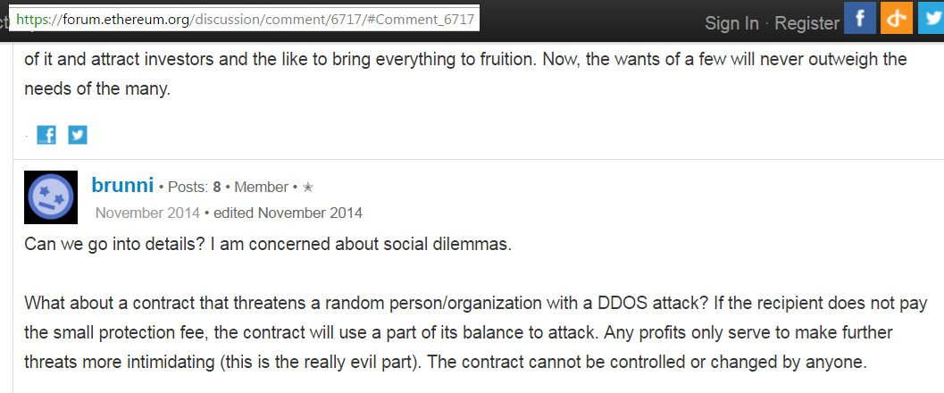
Another Example

Slide 64
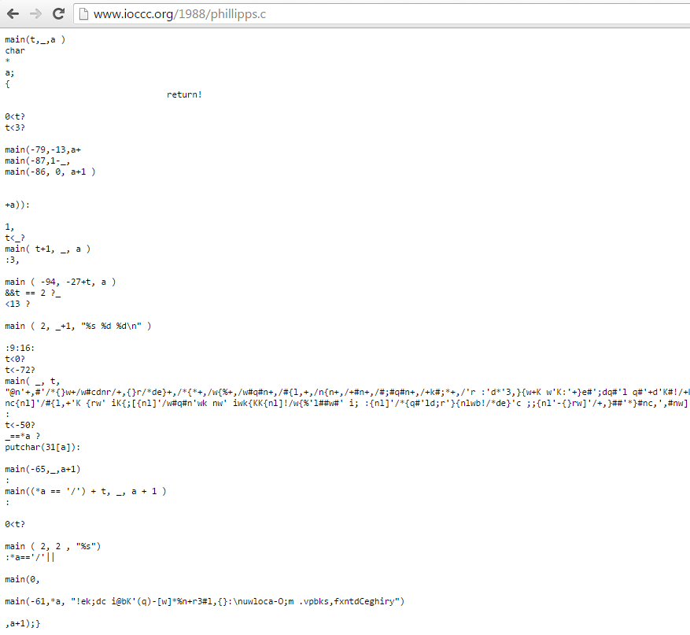
Code Obfuscation
That is a valid computer program. ----→

Slide 65
Restatement
R & D
Treat sidechains with the care/respect of a soft fork:
Slow, Rare
Documented, Discussed
Willfully Activated
Poker
Alarm Clock
Confidential Txns
Alarm Clock
Bad: Many Frequent SCs
Good: Topical SCs Platform
Bet 1
Bet 2
For Betting
Miners need to understand the Sidechains’ purpose.
Bet 2
??
Bet 1
Bet 3
Bet 3
Bet 4
Bet 5
Bet 4
Bet 5
Notes:
Code “whatever you want” on a local machine, the make “the Alarm Clock sidechain” or “the Poker sidechain” or “the Confidential Transactions sidechain”
I’ve written Drivechain so that each new contract always requires initial and ongoing miner-consent.
In the first place, I don’t intend to say that. Primarily, this presentation is about being aware of the interconnectedness of smart contracts, so that we can make an informed decision.
Turing Completeness does not allow us to make such a decision.

Slide 66
Restatement – Internalize the Externalities
Entity
Bitcoin Miners
{ Sha256(Sha256(*)) }
Other Miners
{ Sha3(*) }
Other Miners
{ MD5(*) }
Sidechains
Sidechains
Sidechains
tx fees
Coinbase
If what they are doing affects me, I want a say in it!
Rewards per Block
Notes:
Might affect the value of the coins – the purchasing power exchange rate, or the total quantity of all tx fees.

Slide 67
Conclusion
Avoid the Grey Goo
P. Innovation = Good.
P. Implementation = Bad.
Bet 1
Bet 2
For Betting
Bet 2
??
Bet 1
Bet 3
Bet 3
Bet 4
Bet 5
Bet 4
Bet 5
Mechanism Design / “contracts”
....where the emphasis is on what can’t be done .
...allowing miners to ban things, is appropriate. It’s just a “bigger” version of what a normal contract does.
Script upgrades, MAST, OP_VirtualBox – don’t overdo it!
Notes:
focus should be making it easy for miners to prevent (ie, veto, or steal from) misbehaving sidechains
Otherwise, we are “trusting” that programmers won’t write mean smart contracts (which is ridiculous).
Miners filter double-spent/counterfiet/over-large Bitcoin transactions, this is hardly any different.

Slide 68

Thank You
@truthcoin
paul.sztorc@bloq.com

